Slide 1
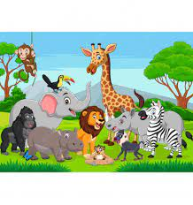
We are Wild about Learning!
Kindergarten Newsletter – August 15-19, 2022
IMPORTANT EVENTS
8/15 | Open House @ 6 pm
The EXPERT in anything was once a BEGINNER!
HOMEWORK
Mon. – Thurs. | Homework will start the week of Aug 22. Please begin going over letters of the alphabet and counting and identifying numbers 1-10.
WEEKLY ASSESSMENTS
ELA | None
Math | None
Breakfast & Lunch
Please fill out the lunch application online and make sure your child brings money or has money on their account for meals. Breakfast $1.75 Lunch $3.00
REMINDERS
Please make sure all money is sent in your child’s blue folder (please label and seal it in a ziploc bag or envelope). If your child is absent, please send an excuse with the following information: Child’s name, date of absence, teacher’s name, and reason for absence.
WEEKLY MATH SKILLS
Understand Counting Drawing 1,2,3 Counting 1,2,3
School Schedule
6:55-7:30 am- Student arrival 2:00 pm –Student Dismissal

